Slide 1
Segmentation and Fairness
in Medical Image Analysis
Fengyi Gao

Slide 2
Agenda
Medical Image Segmentation in Orthopaedic Settings
Segmentation in Medical Image Analysis
Definition
Improved Diagnosis
Treatment Planning
Standardized Analysis
Reducing Noise and Enhancing Visibility
Fairness in Medical Image Analysis
Types of Bias in Medical AI
Strategies for Fair AI in Medical Imaging
Review the Paper: Fair AI-powered orthopedic image segmentation: addressing bias and promoting equitable healthcare

Slide 3

Kurt R. Weiss, MD Associate Professor Director, Musculoskeletal Oncology Laboratory Vice Chair of Translational Research Department of Orthopaedic Surgery, University of Pittsburgh UPMC Hillman Cancer Center

Slide 4
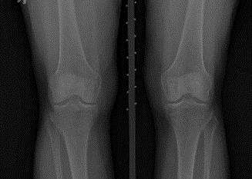
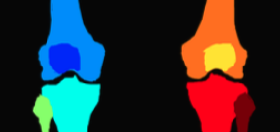
What is Segmentation in Medical Image Analysis?
Segmentation is a fundamental task in medical imaging analysis, which involves identifying and delineating regions of interest (ROI) in various medical images.
Key regions segmented: Organs, bones, tissues, and pathological areas.

Slide 5
Segmentation in Medical Image Analysis
Improved Diagnosis
By delineating anatomical structures or pathological areas, segmentation enhances the ability to detect abnormalities, improving the accuracy of diagnoses.
Treatment Planning
Segmentation aids treatment planning by assessing joint structures, bone alignments, and fractures, as well as tracking disease progression, such as tumor growth.

Slide 6
Segmentation in Medical Image Analysis
Standardized Analysis
Segmentation enables quantitative analysis of anatomical features, such as organ volume and tumor size, improving consistency and reducing subjectivity in clinical decision-making.
Reducing Noise and Enhancing Visibility
Segmentation improves image clarity by isolating key structures, addressing low contrast in X-rays and reducing noise and artifacts that affect visibility.

Slide 7
Fairness in Medical Image Analysis
Fairness in medical image analysis ensures AI models are trained on diverse datasets representing different demographics, such as sex, race, and social determinants of health (SDOH).
This approach minimizes bias in predictions, preventing disproportionate impacts on specific patient groups.

Slide 8
Types of Bias in Medical AI
Data-driven Bias: Bias due to unrepresentative datasets that underrepresent certain populations (e.g., race, gender, age).
Human Bias: Human bias in AI arises from societal prejudices and a lack of diversity in engineering teams, leading to disparities in healthcare outcomes for marginalized groups.
Algorithm Bias: When algorithms reinforce patterns from biased data, leading to skewed predictions, especially in imbalanced datasets

Slide 9
Strategies for Fair AI in Medical Imaging
Pre-processing: Pre-processing methods adjust the input data before training to mitigate bias, using techniques like data reweighting, resampling, and adversarial debiasing.
In-processing: In-processing methods, such as adversarial training and fairness constraints, intervene during model training to reduce bias.
Post-processing: Post-processing methods adjusts model outputs to calibrate predictions and ensure fairness across sub-groups.

Slide 10
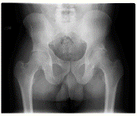
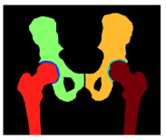
Fair AI-powered orthopedic image segmentation: addressing bias and promoting equitable healthcare
Research Objectives:
To develop an automated image segmentation system that fits well in knee and hip bony anatomy segmentation using plain radiographs.
To uncover and mitigate discernible biases related to gender and racial groups, thus, to build fair segmentation pipeline.
Dataset:
The study computationally assembled a retrospective cohort from the Osteoarthritis Initiative (OAI) consisting of 1,473 plain radiographs from 766 hip and 707 knee patients, with one hip or knee X-ray per patient.

Slide 11
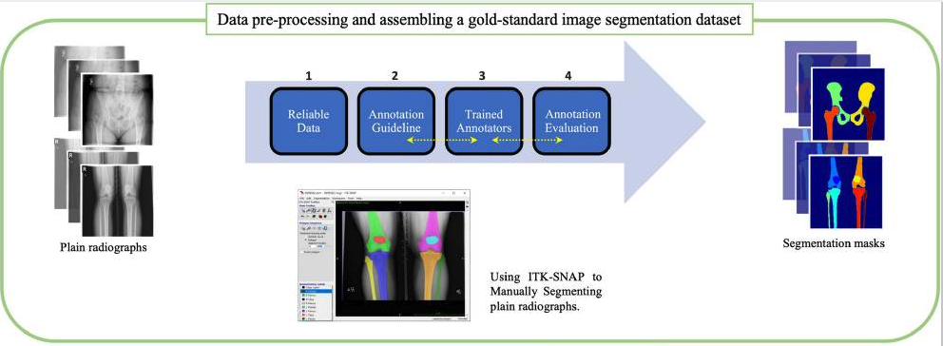
Fair AI-powered orthopedic image segmentation: addressing bias and promoting equitable healthcare
Materials and Methods: Image Annotation

Slide 12
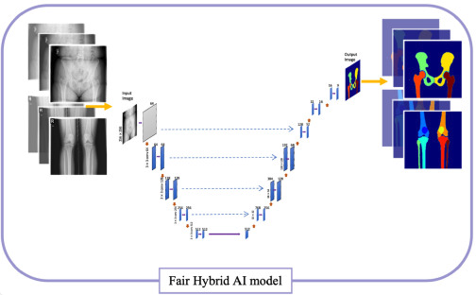
Fair AI-powered orthopedic image segmentation: addressing bias and promoting equitable healthcare
Materials and Methods: Deep Learning Strategy

Slide 13
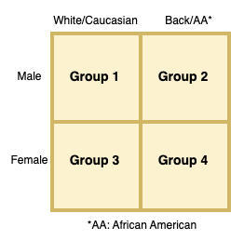
Fair AI-powered orthopedic image segmentation: addressing bias and promoting equitable healthcare
Baseline Model & Bias Mitigation:
Baseline Model: Trained on the entire training dataset.
Balanced Dataset: Under-sampling of the
overrepresented protected groups in the training data.
Stratified Batching: Groups samples based on the protected attributes and then randomly samples instances from each group.
Group-Specific Model: Models are trained separately for different demographic groups

Slide 14
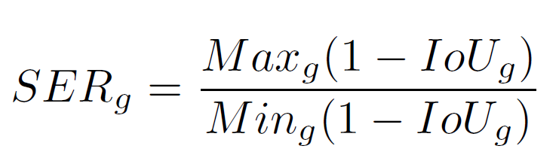
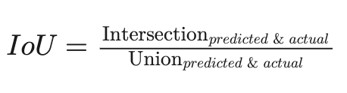
Fair AI-powered orthopedic image segmentation: addressing bias and promoting equitable healthcare
Fairness Evaluation:
Skewed Error Ratio (SER) to evaluate the fairness of the models, focusing specifically on evaluating potential biases in the algorithm’s prediction errors toward specific groups.
It utilizes the ratio of highest to lowest error rate among protected groups.
It should be noted that higher values of SER present a higher presence of bias, while values closer to one are an indication of a lower presence of bias.

Slide 15
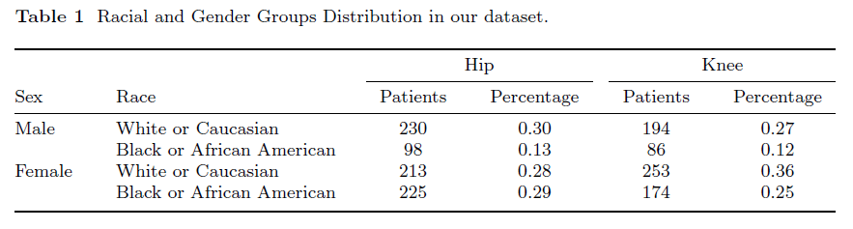
Fair AI-powered orthopedic image segmentation:
addressing bias and promoting equitable healthcare
Experimental Validations & Results

Slide 16
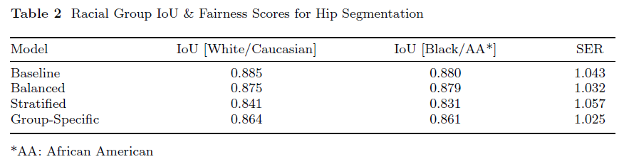
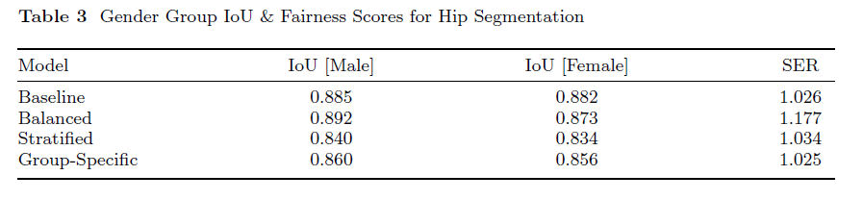
Fair AI-powered orthopedic image segmentation:
addressing bias and promoting equitable healthcare
Experimental Validations & Results

Slide 17
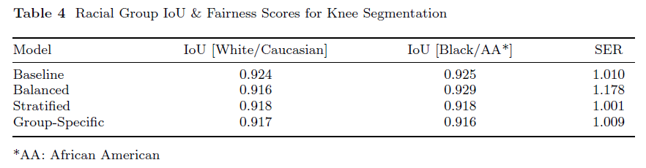
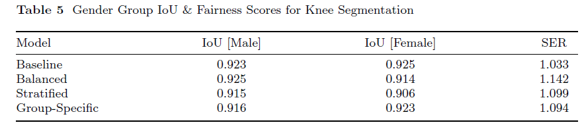
Fair AI-powered orthopedic image segmentation:
addressing bias and promoting equitable healthcare
Experimental Validations & Results

Slide 18



The GitHub repo: https://github.com/pitthexai/AI-in-Healthcare-Research-Symposium/
Short link: http://bit.ly/3FswjVO
QR code:

